Slide 1

Detecting Financial Anomalies GNNs vs. Classical ML vs. Deep Learning
By: Chirag Lakhanpal and Sunisha Harish

Slide 2
01
Introduction
02
Dataset and Preprocessing
03
Graph Neural Networks (GNNs)
Agenda
04
Classical Machine Learning Models
05
Deep Learning Models
06
Experimental Setup
07
Results and Discussion
08
Conclusion

Slide 3
01
Introduction.

Slide 4
Background & Purpose.
Financial institutions process millions of transactions daily
Anomalous transactions may indicate fraud, money laundering, or other illicit activities
Timely and accurate detection of anomalies is crucial for financial security
Compare the performance of Graph Neural Networks (GNNs), Classical Machine Learning, and Deep Learning models for anomaly detection in financial transactions
Identify the strengths and weaknesses of each approach

Slide 5
Challenges & Objectives.
Imbalanced datasets with a low proportion of anomalous transactions
Continuously evolving fraud patterns and techniques
Need for real-time or near-real-time detection
Handling large-scale, high-dimensional, and heterogeneous financial data
Evaluate the effectiveness of GNNs, Classical ML, and Deep Learning models for anomaly detection
Provide insights and recommendations for selecting the most suitable approach based on the study's findings
Contribute to the development of robust and efficient anomaly detection systems in the financial industry

Slide 6
02
Dataset and Preprocessing.

Slide 7
Dataset Description
The Tabformer dataset, provided by IBM on their GitHub repository is a synthetic dataset that closely approximates a real-world financial fraud-detection dataset (IBM, 2021). The dataset consists of 24 million unique transactions, involving 6,139 unique cards and 100,343 unique merchants. Among these transactions, 29,757 are labeled as fraudulent, accounting for 0.1% of the total transactions.
The highly imbalanced nature of the Tabformer dataset, with a significantly lower proportion of fraudulent transactions compared to legitimate ones, is a common characteristic of real-world fraud detection scenarios. This imbalance poses challenges for anomaly detection models, as they need to effectively identify the rare fraudulent instances while minimizing false positives
User | Card | Year | Month | Day | Time | Amount | Use Chip | Merchant Name | Merchant City | Merchant State | Zip | MCC | Errors? | Is Fraud?
0 | 0 | 2002 | 9 | 1 | 6:21 | $134.09 | Swipe Transaction | 3527213246127870000 | La Verne | CA | 91750 | 5300 |  | No
0 | 0 | 2002 | 9 | 1 | 6:42 | $38.48 | Swipe Transaction | -727612092139916000 | Monterey Park | CA | 91754 | 5411 |  | No
0 | 0 | 2002 | 9 | 2 | 6:22 | $120.34 | Swipe Transaction | -727612092139916000 | Monterey Park | CA | 91754 | 5411 |  | No
0 | 0 | 2002 | 9 | 2 | 17:45 | $128.95 | Swipe Transaction | 3414527459579100000 | Monterey Park | CA | 91754 | 5651 |  | No
0 | 0 | 2002 | 9 | 3 | 6:23 | $104.71 | Swipe Transaction | 5817218446178730000 | La Verne | CA | 91750 | 5912 |  | No

Slide 8
Data Preprocessing
The Tabformer dataset undergoes several preprocessing steps to ensure data quality and prepare it for the comparative study on anomaly detection models. The preprocessing pipeline is implemented using a custom function called `preprocess_data`, which takes the dataset as input along with various parameters to control the preprocessing steps.
Firstly, the function automatically detects columns with only two unique values and encodes them as binary (0 and 1). This step helps in representing binary features effectively. Next, the columns are converted to numeric data type when possible to ensure consistent data representation across the dataset.
To handle categorical variables, the non-numeric columns are one-hot encoded, converting them into binary vectors. This encoding technique allows the models to process categorical data effectively. Missing values in the dataset are handled by replacing them with the mode (most frequent value) of each column, ensuring that no data points are lost due to missing information.
To reduce the dataset's size while maintaining the class distribution, stratified sampling is applied based on the 'Is Fraud?' column. This step helps in creating a representative sample of both fraudulent and non-fraudulent transactions. The 'Time' column, which contains datetime information, is treated separately, and appropriate datetime features are extracted from it.
Data cleaning is performed on specific columns to ensure data consistency. The 'Amount' column undergoes cleaning to remove any special characters or inconsistencies. Additionally, columns that may not be relevant for anomaly detection, such as 'Card', 'User', and 'Merchant Name', are removed from the dataset.
Certain columns, including 'Use Chip', 'Merchant City', 'Merchant State', 'Zip', 'MCC', and 'Errors?', are considered as categorical variables and are encoded accordingly. The 'Is Fraud?' column is designated as the target variable for the anomaly detection task.
User | Card | Year | Month | Day | Amount | Merchant_Name | Merchant_City | Merchant_State | Zip | MCC | Errors | Is_Fraud | Time_hour | Time_minute | Use_Chip_Chip Transaction | Use_Chip_Online Transaction | Use_Chip_Swipe Transaction
338 | 2 | 2009 | 4 | 28 | 28.22 | 1456298770479470000.000000 | 0.000029 | 0.000000 | 0.000029 | 0.000000 | 0.00096632 | 0 | 18 | 25 | FALSE | FALSE | TRUE
881 | 0 | 2008 | 10 | 22 | 46.62 | -6161792371494720000.000000 | 0.000057 | 0.000846 | 0.007066 | 0.000018 | 0.00096632 | 0 | 11 | 34 | FALSE | FALSE | TRUE
271 | 4 | 2011 | 3 | 30 | 109.73 | 7824413107036070000.000000 | 0.000000 | 0.001063 | 0.000006 | 0.002401 | 0.00096632 | 0 | 4 | 17 | FALSE | FALSE | TRUE
4 | 0 | 2002 | 6 | 10 | 91.15 | -4317138273541960000.000000 | 0.000000 | 0.000355 | 0.000711 | 0.000000 | 0.00096632 | 0 | 15 | 18 | FALSE | FALSE | TRUE
1934 | 1 | 2019 | 1 | 21 | 63.58 | 1459645998148460000.000000 | 0.000015 | 0.000000 | 0.000015 | 0.000000 | 0.00096632 | 0 | 21 | 43 | TRUE | FALSE | FALSE

Slide 9
03
Graph Neural Networks.

Slide 10
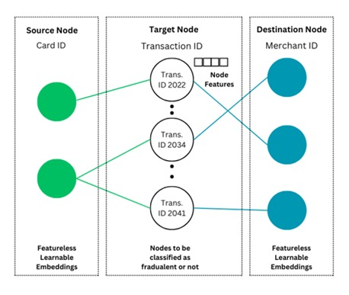
Node Architecture

Slide 11
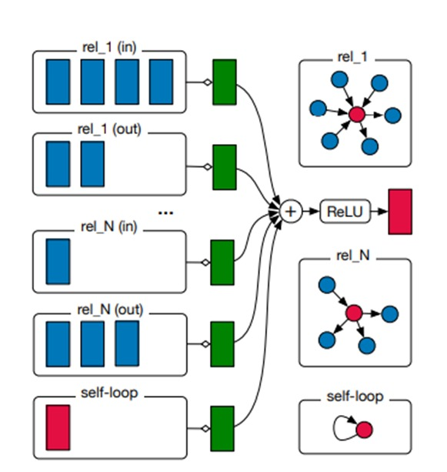

Architecture
Relational Graph
Convolutional Network (RGCN)
Message Passing

Slide 12
Other Architecture Explored
Card and merchant nodes with transaction edges
Captured relationships between cards and merchants
Limited utilization of transaction features
Transaction nodes with logical proposition edges
Emphasized connections between transactions
Did not explicitly capture card-merchant relationships
Incorporating edge features
Enriched representation of transactional relationships
Introduced computational complexity
Featureless edges
Focused on structural information
Limited ability to capture fine-grained transaction characteristic
Node embeddings
Represented cards and merchants in a low-dimensional space ie making them feature less.
Captured inherent properties and behaviors

Slide 13
04
Classical Machine Learning Models.

Slide 14
Traditional Machine Learning Models Used.
Overview
Classical machine learning models are widely used for anomaly detection in financial transactions
Models used in this study: XGBoost, CatBoost, Logistic Regression, LightGBM, and Random Forest
XGBoost (Extreme Gradient Boosting)
Ensemble learning algorithm that combines multiple weak learners (decision trees) to create a strong learner
Employs gradient boosting to iteratively minimize the loss function and improve performance
Handles missing values and supports parallel processing for faster training
CatBoost (Categorical Boosting)
Gradient boosting algorithm that effectively handles categorical features without the need for extensive preprocessing
Uses ordered boosting and symmetric trees to reduce overfitting and improve generalization
Provides robust performance and fast training times

Slide 15
Logistic Regression
Probabilistic model that estimates the likelihood of an event (anomaly) occurring based on input features
Learns a linear decision boundary to separate anomalous and normal transactions
Simple and interpretable model, but may struggle with complex, nonlinear relationships
LightGBM (Light Gradient Boosting Machine)
Gradient boosting framework that uses a leaf-wise tree growth strategy for faster training and lower memory usage
Employs histogram-based algorithms to handle large-scale data efficiently
Supports parallel and GPU learning for accelerated training
Random Forest
Ensemble learning method that constructs multiple decision trees independently and aggregates their predictions
Each tree is trained on a random subset of features and samples, promoting diversity and reducing overfitting
Provides robust performance, handles high-dimensional data, and estimates feature importance

Slide 16
05
Deep Learning Models.

Slide 17
Deep Learning Models Used.
CNN: Convolutional Neural Networks, widely used for image classification tasks, leveraging convolutional layers to automatically extract hierarchical features from input data and achieve superior performance in visual recognition tasks.
LSTM: Long Short-Term Memory networks, a type of recurrent neural network (RNN) equipped with memory cells capable of capturing long-range dependencies in sequential data, commonly applied in natural language processing and time series forecasting tasks.
CNN-LSTM: A hybrid neural network architecture combining convolutional and recurrent layers, adept at processing both spatial and temporal information, often utilized in tasks involving sequential data with spatial dependencies, such as video analysis and sensor data processing.

Slide 18
06
Experimental Setup.

Slide 19
Evaluation Metrics
Due to the highly imbalanced nature of the dataset, the following metrics are used to assess model performance:
F1 Score: Harmonic mean of precision and recall, providing a balanced measure of model accuracy
Recall: Measures the proportion of actual anomalies correctly identified by the model
Precision: Indicates the proportion of predicted anomalies that are actually true anomalies
AUC-PR (Area Under the Precision-Recall Curve): Summarizes the trade-off between precision and recall at different classification thresholds, suitable for imbalanced datasets
Machine Specifications
Amazon EC2 g5.2xlarge instance
GPU: 1 x NVIDIA A10G Tensor Core GPU
GPU Memory: 24 GB GDDR6
vCPUs: 8
Memory: 32 GB
Storage: 50 GB
GPU specifications enable faster training and inference times for deep learning models
Train-Test Split Strategy
Stratified sampling is applied using the 'is_fraud' label to ensure that the class distribution is preserved in both the training and testing sets
This strategy helps maintain the imbalanced nature of the dataset during model training and evaluation

Slide 20
07
Results and Discussion.

Slide 21
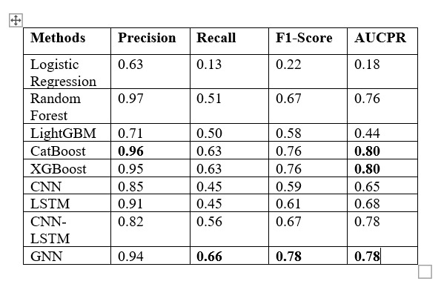
Results.

Slide 22
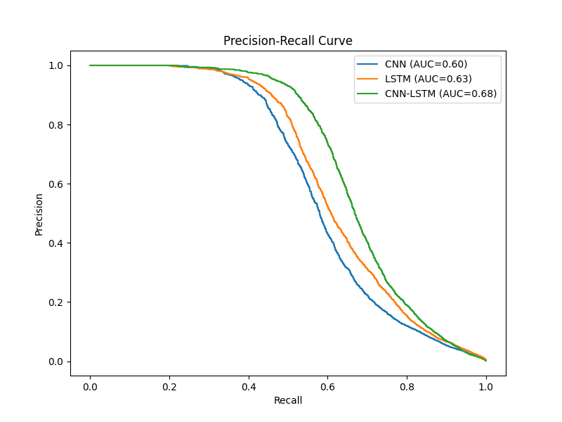
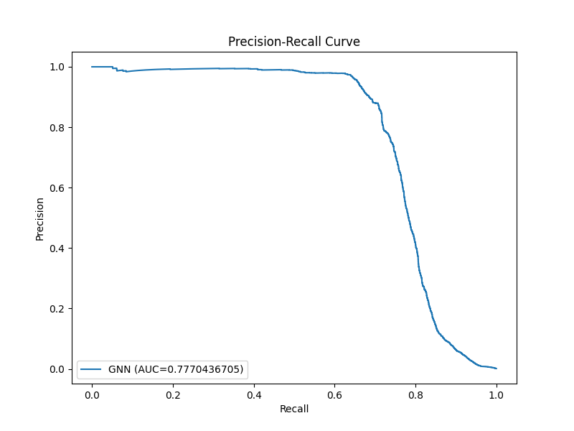
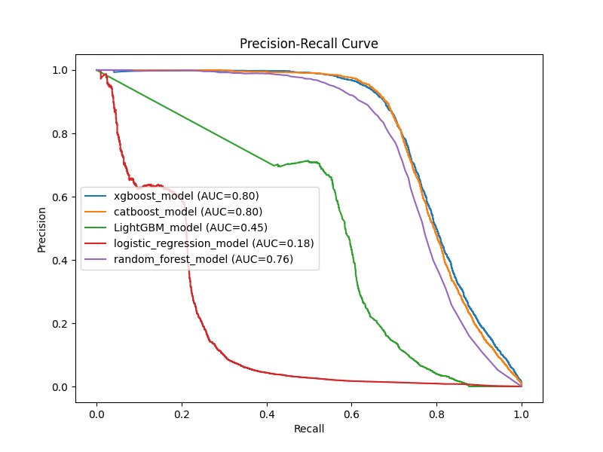

Slide 23
08
Conclusion.

Slide 24
Key Findings
Our proposed Graph Neural Network (GNN) model outperformed all other models, achieving an impressive F1 score of 0.78 for anomaly detection in financial transactions.
The heterogeneous graph framework introduced in this study addresses the limitations of existing graph representations in transactional networks by placing transaction nodes at the center and incorporating learnable parameters for card and merchant ID nodes.
The effectiveness of GNNs in this context highlights their potential for various applications, including fraud detection, recommendation systems, and beyond.
Future Research Directions
Incorporating sampling strategies and edge weights into the heterogeneous graph framework presents a promising avenue for future work, offering opportunities to improve scalability, efficiency, and predictive performance in transactional network analysis and related domains.
Integrating attention mechanisms into the heterogeneous graph can enhance the model's ability to capture complex relationships by allowing nodes to focus on relevant neighbors during message passing.

